Slide 2
Objectives
Understand the meaning of primary storage including the role of:
Random Access Memory (RAM)
Read Only Memory (ROM)
Describe the difference between RAM and ROM and why both are needed
Describe what is meant by virtual memory including:
How it is created and used
The reason it is necessary

Slide 3
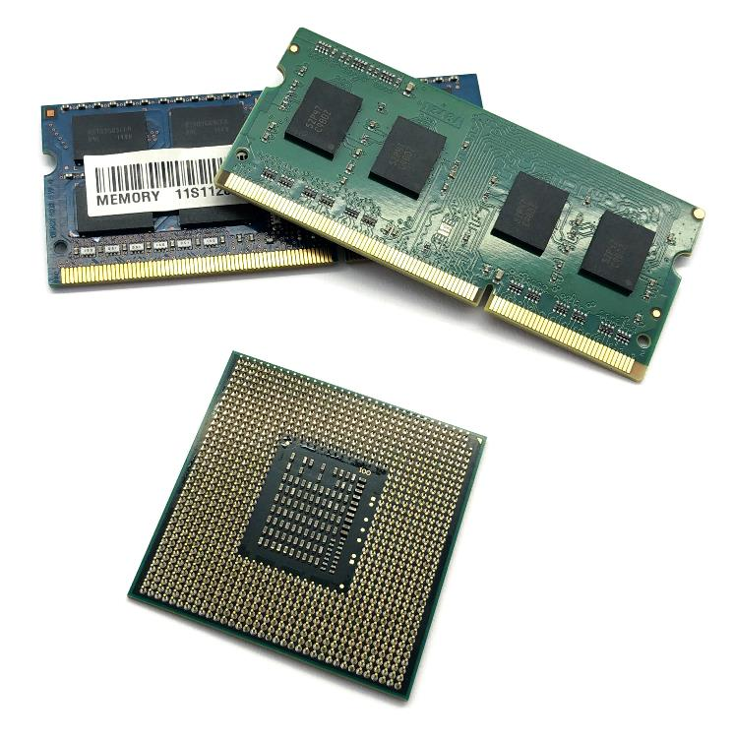
Starter
What are four types of memory that are used in computers systems?

Slide 4
Starter
From previous lessons:
CPU registers
Cache
This lesson:
RAM
ROM
Virtual memory

Slide 5
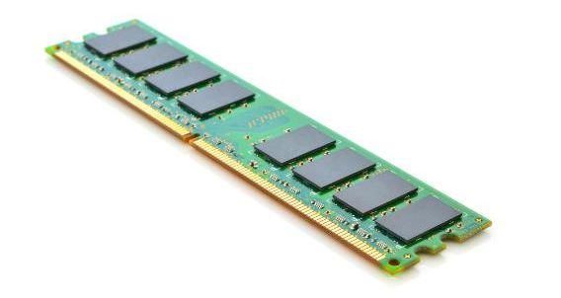
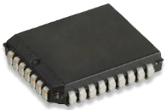
Types of primary storage
There are many types of memory used in computers
In the Von Neumann architecture, primary storage is directly accessed by the CPU and is needed to store programs that are currently running
The two types used as primary storage are:
RAM (Random Access Memory)
ROM (Read Only Memory)
RAM
ROM

Slide 6
RAM
RAM stores programs or data that are running or open
It is directly accessed by the CPU
When your computer is turned off, data stored in RAM is lost
RAM is volatile as it loses data if the power is off
All your programs and data are stored permanently on your hard drive
This is known as non-volatile storage as it doesn’t lose the data if the power is off

Slide 7
Worksheet 4
Complete Task 1 on Worksheet 4

Slide 8

RAM
When the computer is first turned on, no data is stored in RAM
RAM
Empty

Slide 9
Operating system
The computer first loads the operating system from your hard drive into RAM
RAM
Operating system

Slide 10

Programs and data
When applications or programs are loaded, they are copied into RAM from the hard drive
Documents and files (data) that are used with those programs are also opened by copying them into RAM
RAM starts to fill up as all these programs, documents and files are copied
RAM
Documents in use
Clipboard
Excel
Word
Operating system

Slide 11
Running out of space
You now want to open a browser to search the Internet
The browser software needs more memory than you have free in RAM
What do you think happens?
RAM
Documents in use
Browser
Clipboard
Excel
Word
Operating system

Slide 12

Virtual memory
Virtual memory is part of the hard drive used as an extension to RAM
A page of data is a fixed-length block of virtual memory
When pages of data are moved between RAM and hard disk this is known as swapping or paging
What are the advantages and disadvantages of using part of the hard disk in this way?
Hard Disk
RAM
Browser
Documents in use
Clipboard
Word
Operating system
Excel

Slide 13
Virtual memory
Advantages
Uses cheap secondary storage on the hard drive
Prevents error messages saying ‘out of memory’ – the programs and files will still open
Disadvantages
Accessing virtual memory is very slow
To access data, the existing data in RAM needs to be copied to the virtual memory, then data in virtual memory needs to be copied to RAM

Slide 14
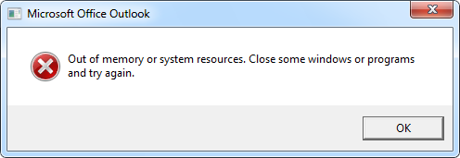
What happens when RAM completely fills up?

Slide 15
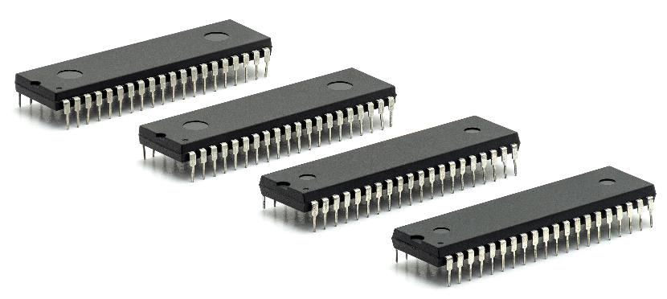
Read-only memory (ROM)
Some data needs to be permanently held in primary storage, even when a computer has no power
Read-only memory (ROM) is used to store this data
Data is read from ROM, but cannot be written to it
It is non-volatile as the data isn’t lost if the power is off
What is stored in ROM on a modern computer?

Slide 16
ROM
ROM is used in modern computers to store:
The initial program that is run when the computer is turned on
This is known as the bootstrap
It tells the computer where it will find the operating system on the hard drive
It also stores the Basic Input/Output System (BIOS)
The BIOS can run without a hard drive or other secondary storage being present
It controls basic technical configuration of the computer such as the processor speed and system time

Slide 17
RAM vs ROM differences
Characteristic | RAM | ROM
Size | Typically 4 GB – 32 GB | Typically 4 MB – 8 MB
Used to store | Running programs and operating system | BIOS and bootstrap
Read ability | Yes | Yes
Write ability | Yes | No
Volatile | Yes | No

Slide 18
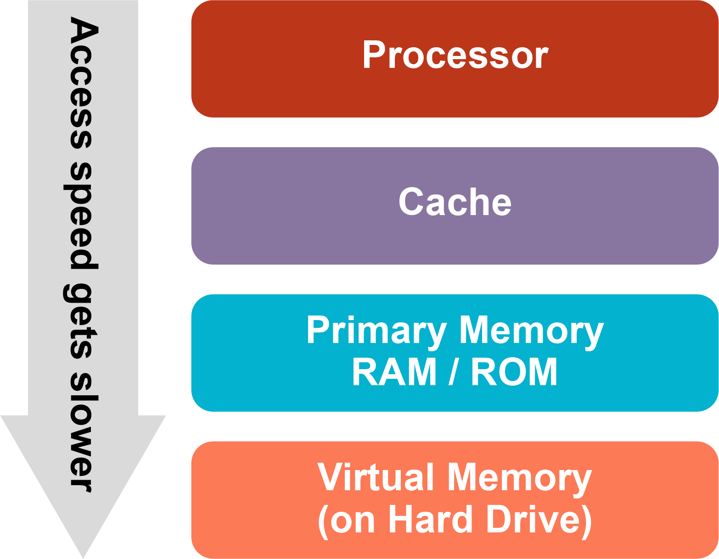
Memory speed
The speed that data can be accessed changes through the different components in a computer
The slower components are far cheaper for each byte of data stored

Slide 19
Worksheet 4
Complete Task 2 on Worksheet 4

Slide 20
Plenary
In pairs test each other on the following:
What does RAM stand for?
What does ROM stand for?
Name one difference between RAM and ROM
How much RAM is typically available in a modern personal computer?
Why is virtual memory much slower than RAM?

Slide 21
Plenary
RAM stands for Random Access Memory
ROM stands for Read Only Memory
RAM can be written to, ROM can’t ROM is non-volatile, RAM is volatile
Typically, a modern personal computer will have 8-32 GB of RAM available

